Slide 1
Presentation2
Information gathering

Slide 2
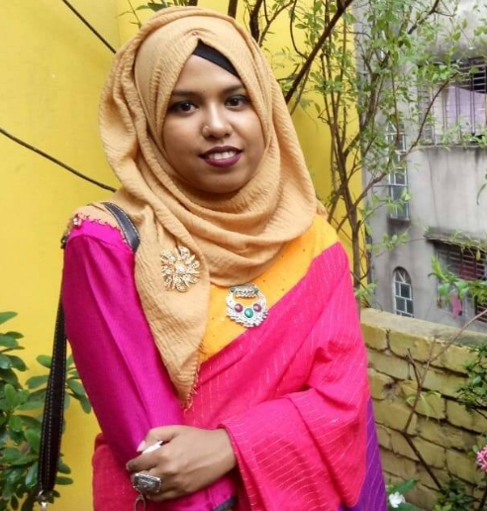
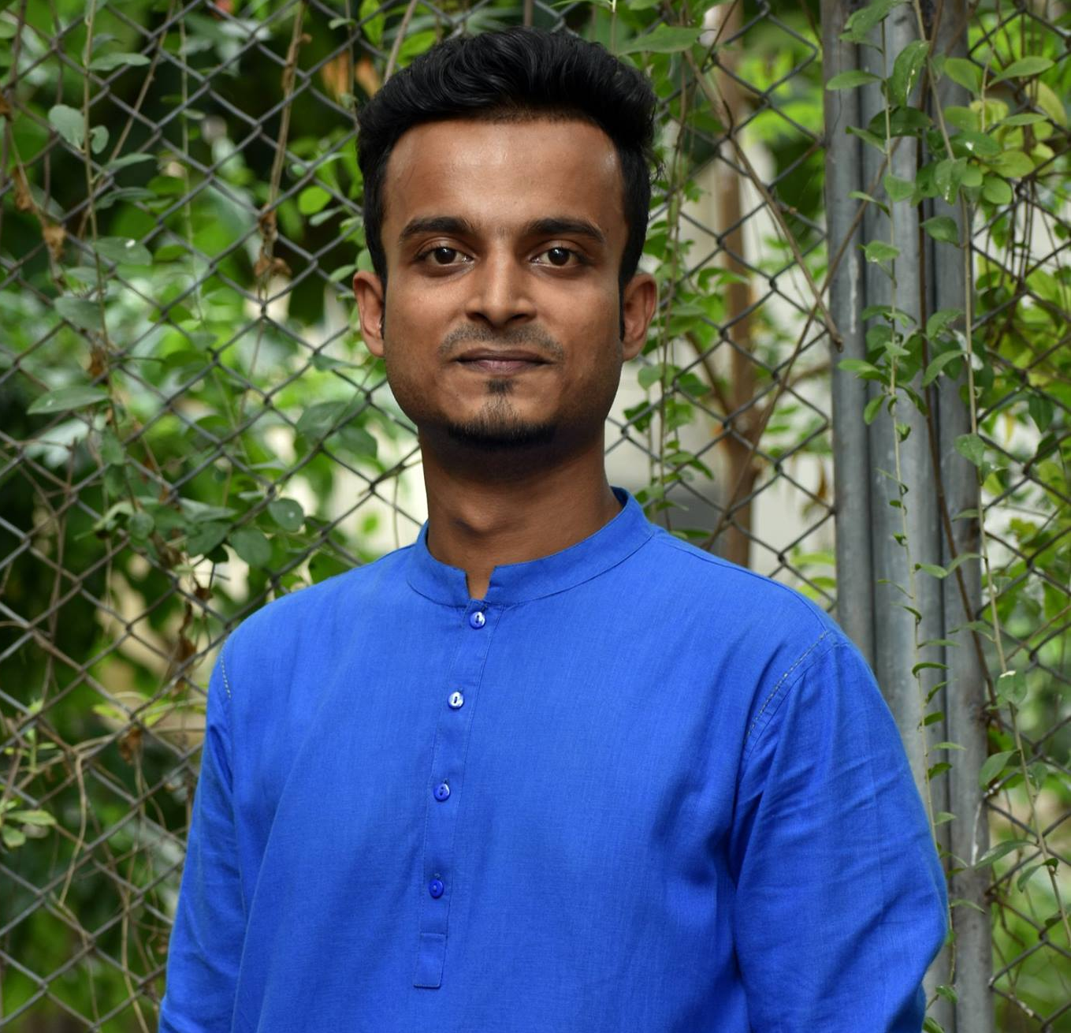
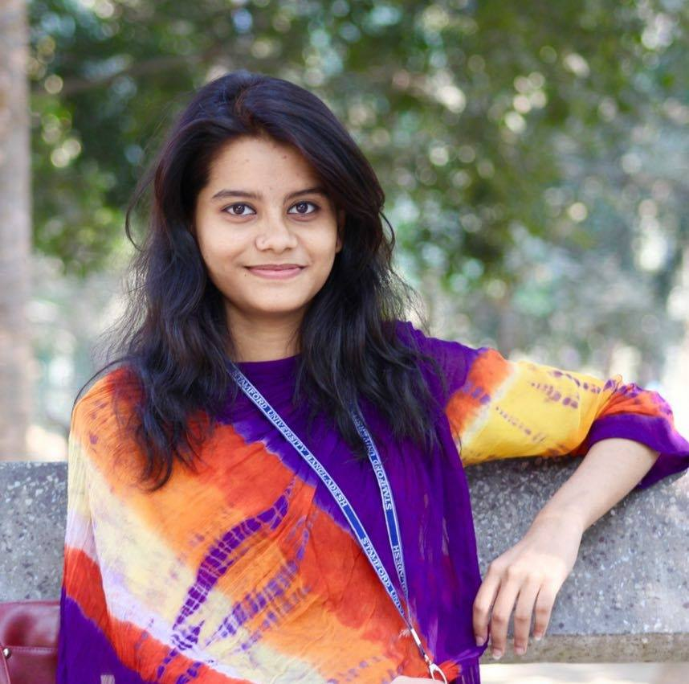
Group Name: Tierce
Nafisa Lubaba Rafisa
CSE 063 07432
Naimul Islam
CSE 063 07444
Rezwana Karim
CSE 063 07453

Slide 3
Objectives:
Making simple but significant questions.
Understanding the peoples view.
Understanding the needs for our project.
Requirement analysis.
Analyzing features.

Slide 4
Pattern:
Interview
Questionnaire
Investigation

Slide 5
Interview information
Participants: Mrs. Afroza Akhter
Designation: Assistant teacher
KPB School and College
Date: 10-9-2019
Duration: 13 mins.

Slide 6
Total interview procedure
Question 01: There are many kinds of students in your class, which kind of problem you faces in the class during teaching and how you manage them?
Answer: There are many kinds of children but some children are with extra special demand, so to earn their concentration on study I use some educational instruments. Like I let them to write on the board with the marker, that’s why they enjoy it so much to write like me on the board.

Slide 7
Question 02: If we let the children to learn and understand their study in their own way, then will they be able to learn better?
Answer: Some children are exceptional; they learn their lesson very fast from textbook but maximum children wants to enjoy and they understand their lesson better if we let them to learn and understand in their own way.
Question 03: Do you support digitalization process in education?
Answer: Yes. We have digital process for teach our students. We have a computer lab and, in this lab, we take a special class called MM (Multimedia) class for teach the students with digitalization and children’s enjoyment.
Question 04: In present situation parents and teachers often says that children are very much involved with internet, mobile phone, laptop etc. so if we use this opportunity to move them toward study with fun, then what is your opinion about it?
Answer: I’m also a mother and I have two children. I saw that if they get a free time then they start using internet or playing game. So I think if you create something interesting for them to learn their study then it will be a great work.

Slide 8
Question 05: To get children’s attention on their study we will add video based content and some animation content in our project. So what do you think we should add something new feature in it?
Answer: If you start video and animation-based content for children’s study at starting of your project that maybe work but if you add something interesting and enjoyable content like “Meena Mithu”, “Doraemon” to get the children’s attraction on your project then it will must be work. Or though children’s loves new things if you can create a new character for them it will be a great success.
Question 06: As a guardian what is your opinion about our project? Will you allow your child to use our software for their study?
Answer: In NCTB book’s their have many cartoons wise picture for children’s study. So it is important to study the NCTB book. But if I see that your project have something teachable for children then I’ll recommend my children to use it beside the NCTB book. And if they find something interesting in your project then they will use it must.
Question 07: What will be the impact of our project on nowadays children?
Answer: If you create a new and interesting character like “Doraemon” and “Meena Mithu” to get the attention of children’s and if you try your best honestly then I expect that it will be a great project.

Slide 9
Question 08: As in the school, after finishing a chapter teacher take a test on this chapter, we wanted to add a test feature like that and also add a feature for parents to send their feedback about their children, what do you think this feature will be good or bad?
Answer: If you add this kind of feature that will be very best process in your project. Practically when I teach my students and take tests then I saw them in front of my eye. So, I can take their feedback instantly. If you wanted to do something like that then you must add this features. Parents will also like this idea of your project.
Question 09: What could be the hurdle/barrier of our project?
Answer: One barrier maybe you will face, which is parents may not understand about your project good or bad.
Question 10: Which process we can use to let the parents know about our project?
Answer: You can use social media and also create an advertisement process for parents to let them know about your project easily

Slide 10
Question 11: We know that many coaching center use leaflets or arrange a meeting with teacher and guardian to know about them, how do you think if we do something like that?
Answer: You can do workshop in some school. It will help in both advertisement and make everyone understand our project.
Question 12: What is your own opinion about our project?
Answer: From the deep of my heart I would like to say that you are doing a great project. It is unique and wish that it will be beneficial in nowadays children’s study. Carry on. Best of luck.

Slide 11
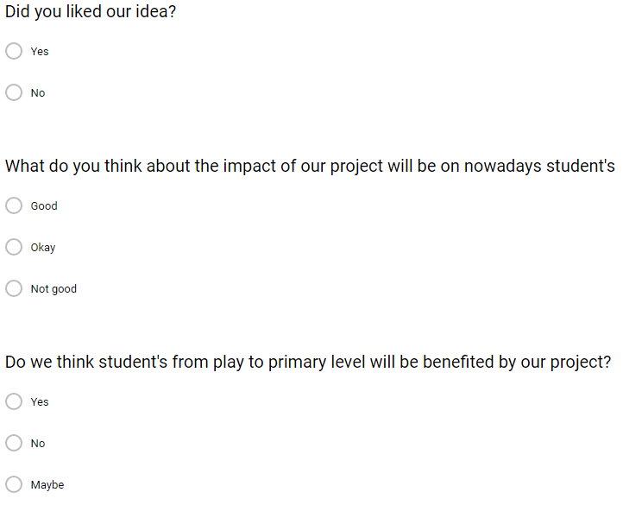
Questionnaire:

Slide 12
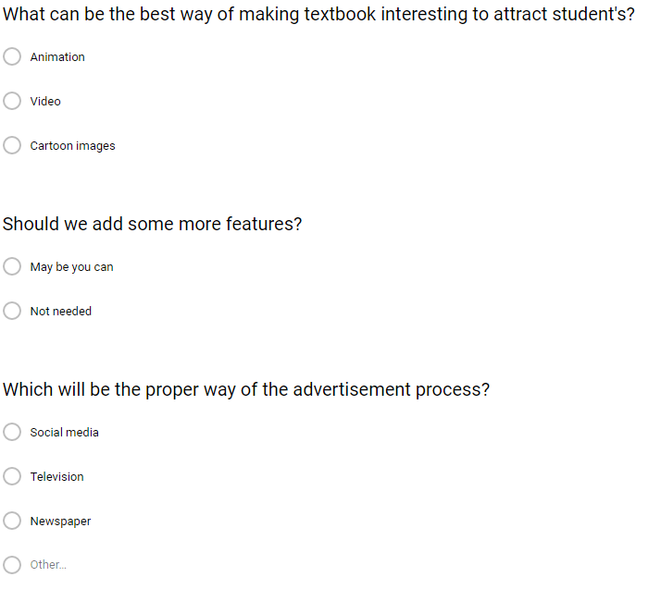
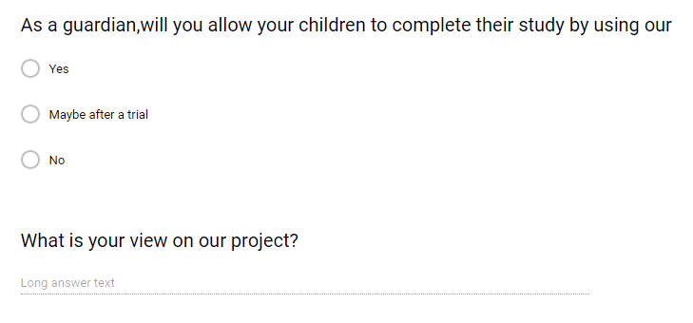
Questionnaire:

Slide 21
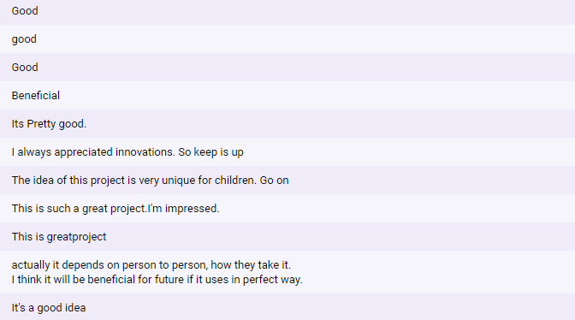
View’s on project:

Slide 22
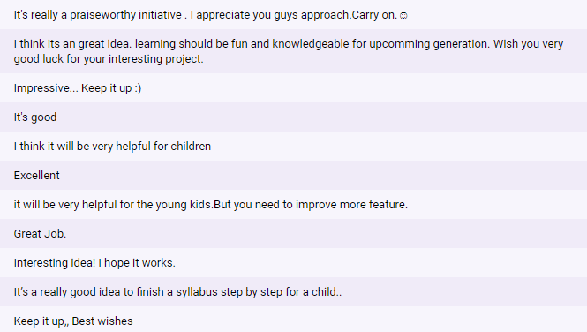
View’s on project:

Slide 23
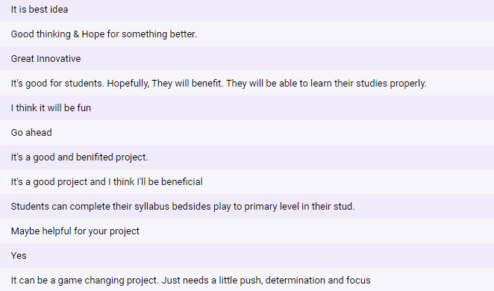
View’s on project:

Slide 24
Investigation:
BYJU’S-The Learning App is the highest rated app (for apps with over 10 million downloads) across categories with a 4.7 rating.
Today, BYJU’S has over 12 million downloads, 700,000 annual paid subscriptions and sees an addition of 40,000 students every month.
With an average time of 51 minutes being spent by a student on the app every day from 1700+ cities, the BYJU’S app is making learning enjoyable and effective.
Annual renewal rates are as high as 90%, which is a validation of its effectiveness.

Slide 25
Revised Requirement Analysis:
Animation will be the best to make textbooks interesting
Features may be added.
Parent’s will let their children to use our software after a trial.

Slide 26
Summary:
Although not much changes were found, the following points should be kept in mind:
We have found a majority of using animation content. So we will be featuring that content.
We have to be concern about parents thinking for let their children to use our software.
We are going to advertise through social media because 84.5% agreed with this.

Slide 27
Summary:
We have found a majority of using animation content. So, have to give much importance in this.
We have to be concern about parents thinking for let their children to use our software.
We are going to advertise through social media because 84.5% agreed with this.

Slide 28
Thank You

